Slide 1
WHOI IS Applications Development Group
How can we help you?
Notes:
Who Am I
25+ years in the software industry
Started out writing embedded code & worked my way up
EE degree
worked in the manufacturing industry and before here in Finance
Published 5 books on software programming

Slide 2
History
CIS was focused on helping the infrastructure and Science community
MIS was dedicated to helping the Admin community
Different tools and methods of working
Now combined for to create a single IS team under Keith Glavin
We are stronger as a combined group and are here to help everyone
The IS Web site is at http://whoi-it.whoi.edu/
The IS App Dev Web site is at http://whoi-it.whoi.edu/our-services/software-development/
Notes:
CIS and MIS were different groups and were in different locations
Used different tools. Such as Microsoft vs Open Source
Lots of duplication because of this
All one happy family now.

Slide 3





We Speak Your Language
Python
R
PHP
Java
HTML5, JavaScript, CSS
C#
SQL
C++
Notes:
We are using Python in several projects
OOI
IFCB
Protein Portal
Python ubiquitous in WHOI
R is used quit a bit but no-one has expertise
We are getting expertise as a contractor
we are using it in Lipidomics for Ben Van Mooy
PHP
Used extensively in WordPress
Java
Used for all of the WHOI CMS
C++
I have used it extensively in the past
We are getting expertise in this via contractor

Slide 4





We know the Frameworks
WordPress
Drupal
Django
Flask
Java Struts using Hibernate ORM
.NET
Notes:
New CMS and all new sites are WordPress
Drupal is used in WHOI but we have little support for it
Django is the framework of choice for scientific web sites. Using it now in 2 projects. Python based.
Flask is a lightweight Python web framework we use it for the IFCB web site.
Java Struts is used in the WHIO CMS
.NET software used mainly in the Admin space

Slide 5

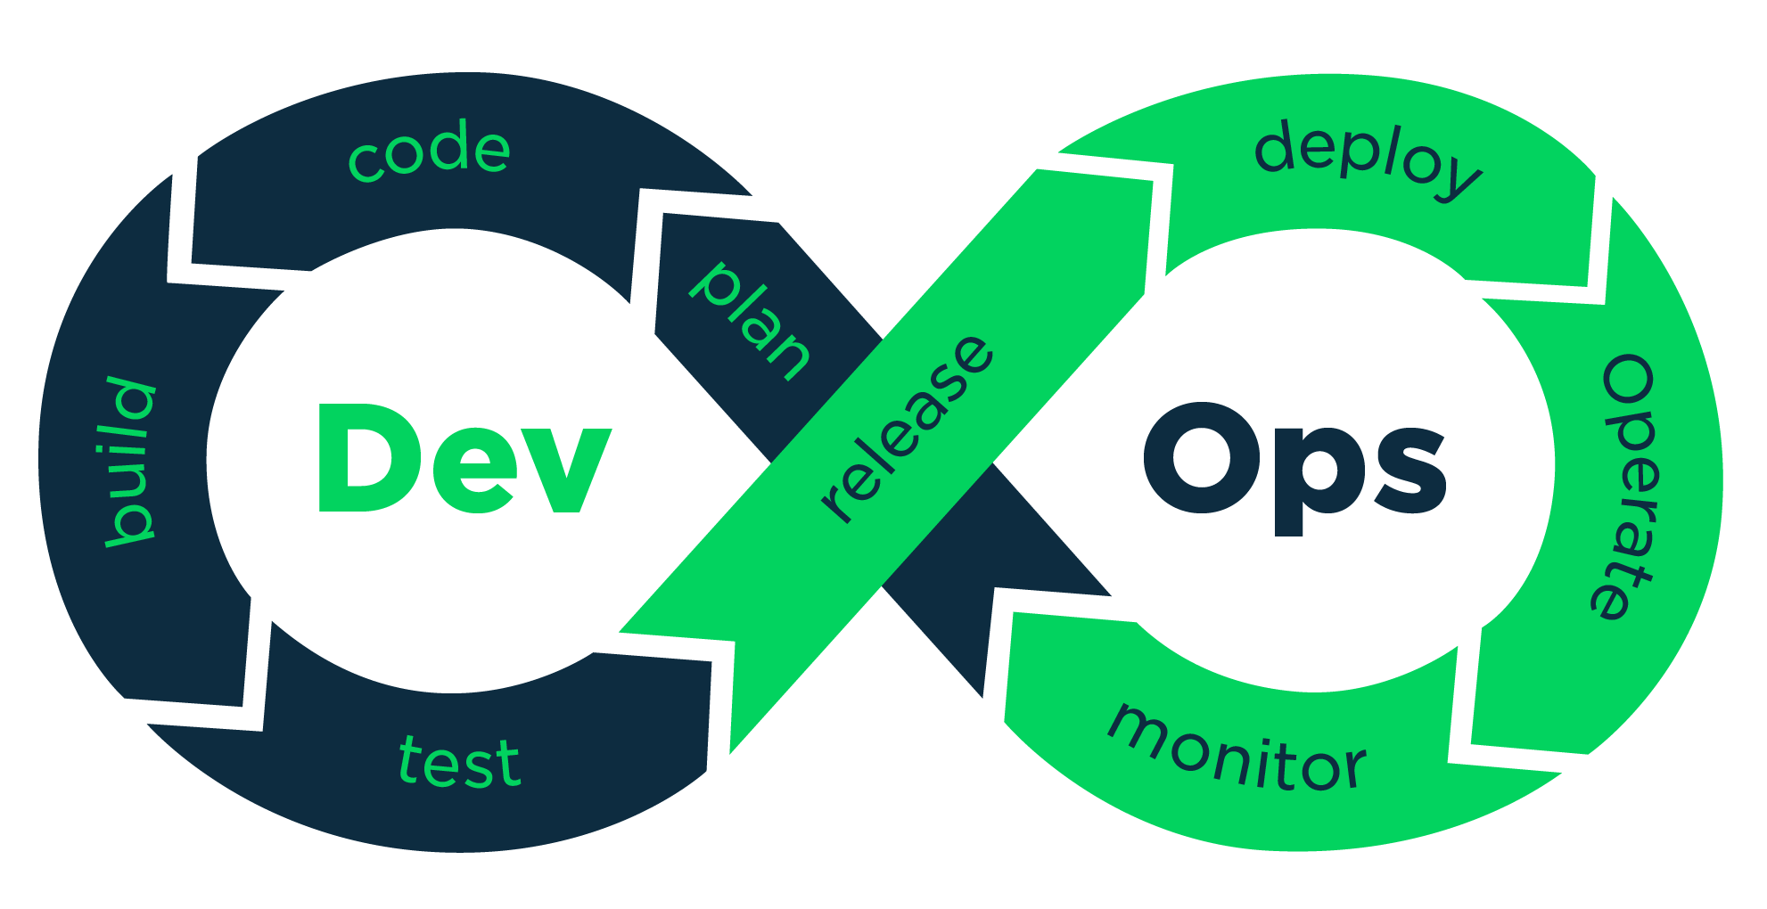



We Know the Workflow
Git
Bitbucket
DevOps
Jupyter Notebooks
Vagrant
Docker
Notes:
What is Git and Bitbucket and how are they different
DevOps = constant release using Git, unit tests, regression tests, staging servers, etc.
Jupyter Notebooks are a great way to try something out and document it. Mainly used for python development
Vagrant is used as a VM on your machine. It used VirtualBox (mostly) and there are dozens of boxes out there.
Docker is like Vagrant but it does not include the OS host. Docker containers are lightweight and easily passed around.

Slide 6





We Know the Techniques
Tensor flow
Parallelizing code
Map Reduce (Hadoop)
NumPy, SciKit, etc.
Workflow Automation
Collaboration Tools
Notes:
Map Reduce = Hadoop
Collaboration tools = slack, GIT, Jira
Workflow automation. Talk about Lipidomics and how we want to automate that.

Slide 7






We Know Data
RDBMS (PostGreSQL, MySql, MSSQL, Access)
Document databases (Mongo)
Graph databases (Neo4J)
ERDDAP
ElasticSearch
Notes:
PostGres, MySql, Sql Server. DB design and query design. DB Management
Mongo good for unstructured data
Neo4J good for making relationship connections
Ontologies
ERDDAP good for storing NetCDF files and outputting in dozens of formats. REST interface
ElasticSearch based on Lucene and is extremely fast at faceted searching

Slide 8
Our Portfolio
http://whoi-it.whoi.edu/appdev-application-portfolio/
OOI
Lipidomics
Proteomics
IFCB
AOP&E (DSL)
Machine learning for classification
New Personal Sites
New Admin Forms

Slide 9
Our Team
Ready to help you
Nick Symmonds
Helen Gordon
Joe Futrelle
David Gaylord
Adam Shepherd
Julie Allen
(1) Contract TBH
(1) FTE TBH
Our team will grow in size over the next year

Slide 10
Future Talks
Source control using Git, Bitbucket
Workflow and Jupyter Notebooks
Vagrant Containers
Using Docker

Slide 11
Slides
Introduce me
IS History
We speak your language
We know the frameworks
We know the workflow
We know the techniques
We know data
Our portfolio
Our Team
Future talks
User community git

